Slide 1
REQUEST LOG ANALYSES
TEAM:
PIKACHU
MEMBERS:
SAMHITHA TUMMANAPALLI
MD USMAN GANI SYED
AKHILA ATLURI
NAVYA RAMYA SIREESHA

Slide 2
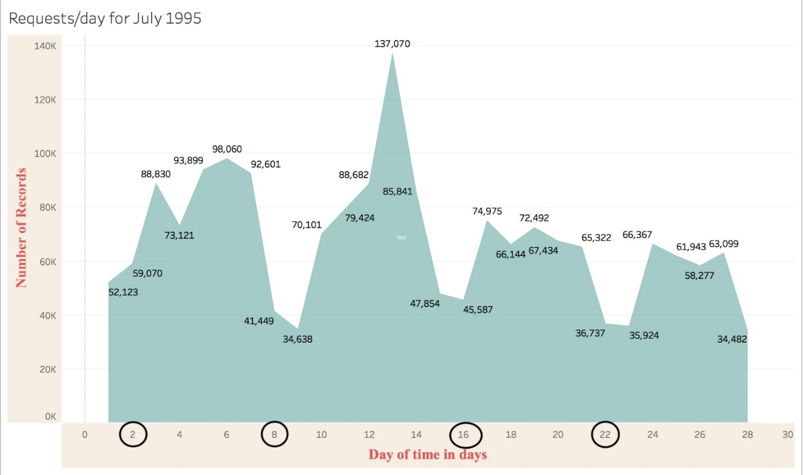
Requests Per Day for July 1995

Slide 3
ANALYSIS:
On weekends, the number of requests received per day is approximately half the number of requests received on weekdays.
PREDICTION :
So we can predict that, in future also, the load will be high on weekdays and low on weekends.

Slide 4
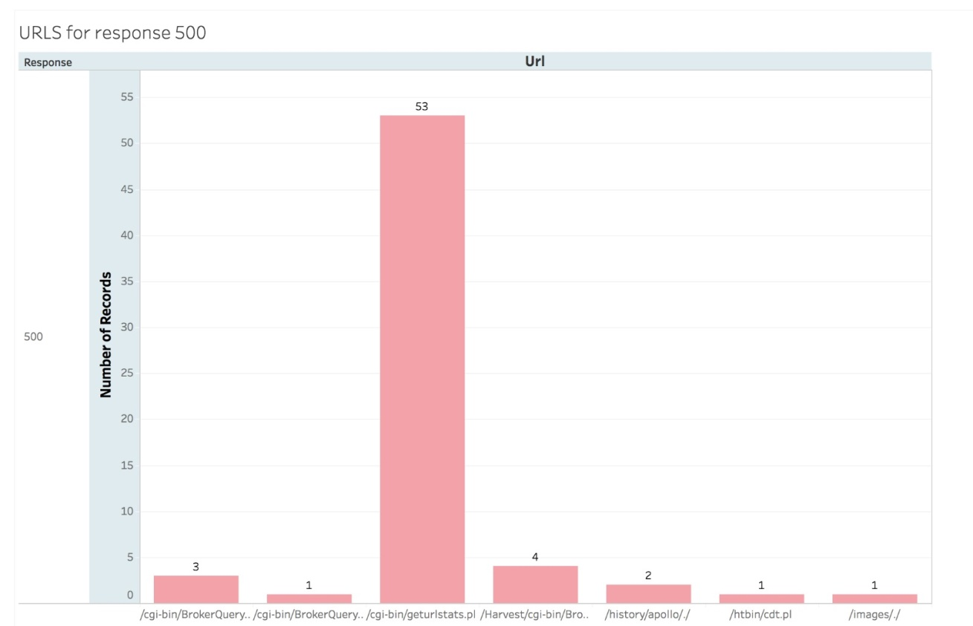
Requests Count Per URL with Response StatusCode 500

Slide 5
ANALYSIS:
The total number of requests for which we received status code 500 is 65.
The count of this particular URL "/cgi-bin/geturlstats.pl" is 53. So there might be some problem in its business logic. So if we start bug fixing, then this API must be fixed on priority.

Slide 6
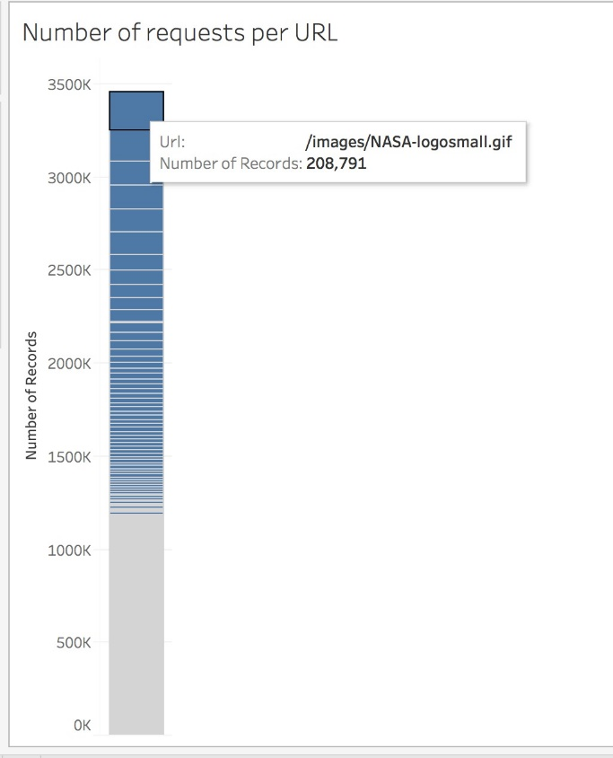
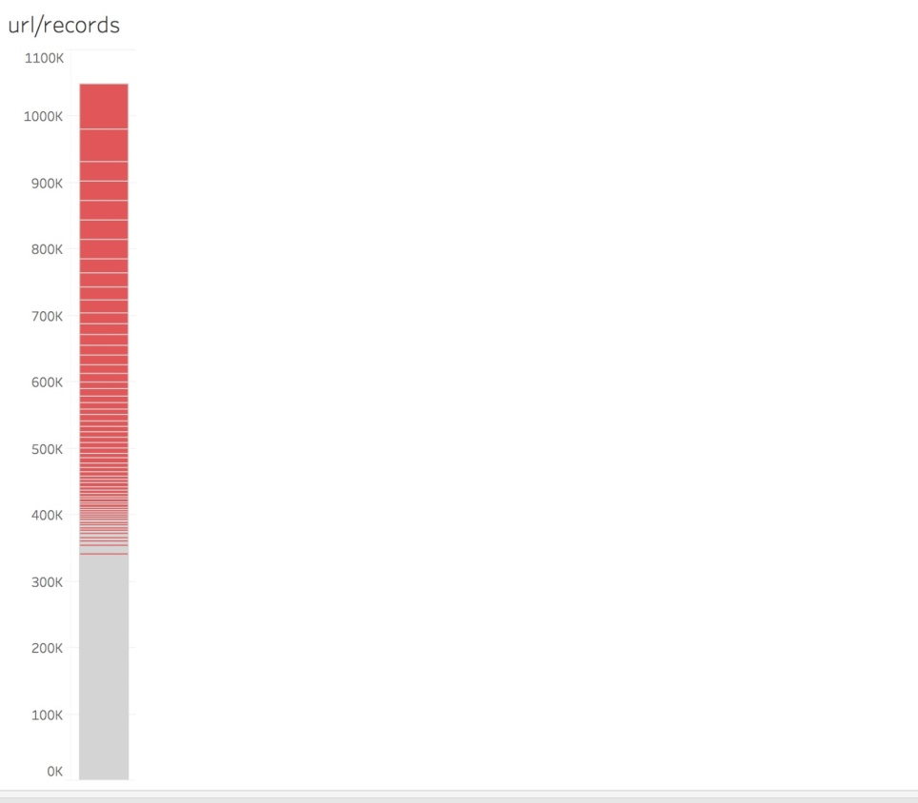
NUMBER OF REQUESTS PER URL

Slide 7
ANALYSIS :
As the number of requests per URL increases, load on the server also increases. The pagerank for that URL increases as the number of visits to that page increases.
PREDICTION:
More chance of server getting hanged while accessing the URL /images/NASA-logosmall.gif as many users are accessing at the same time. Hence there is need to maintain load balancing.

Slide 8
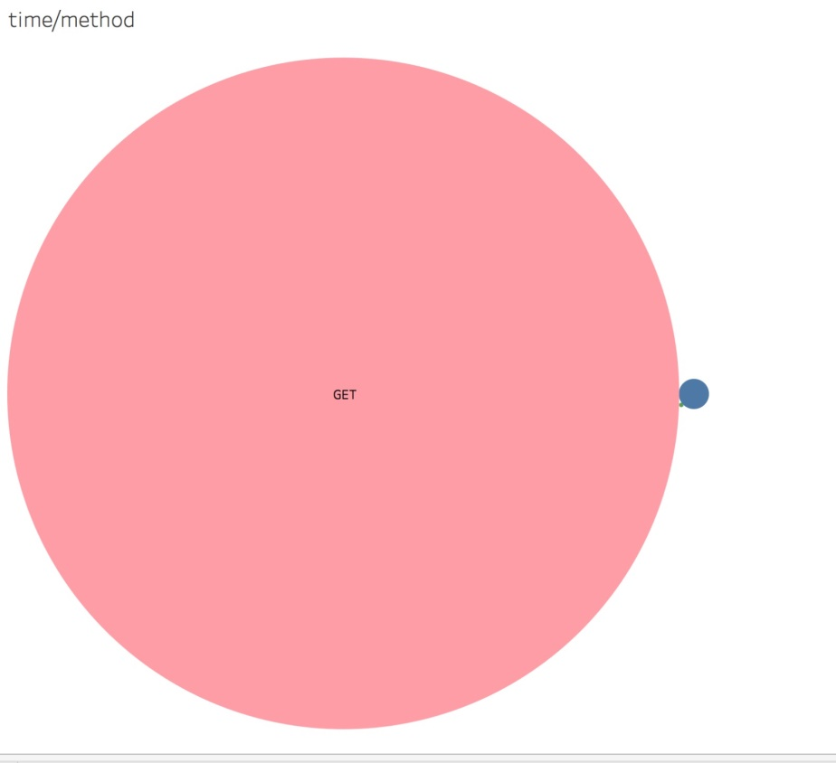
Time/Method

Slide 9
TIIME/METHOD
ANALYSIS : Most of the users use GET method,limited no. of users use POST method and moderate no.of users use HEAD method
Users take large amount of time to retrieve data and less amount of time to post the data
PREDICTIONS:Distributing the data on different servers so that load balancing is made.
When multiple users work on same method,there is possibility of radio jamming.
Hence appropriate measures should be taken.

Slide 10
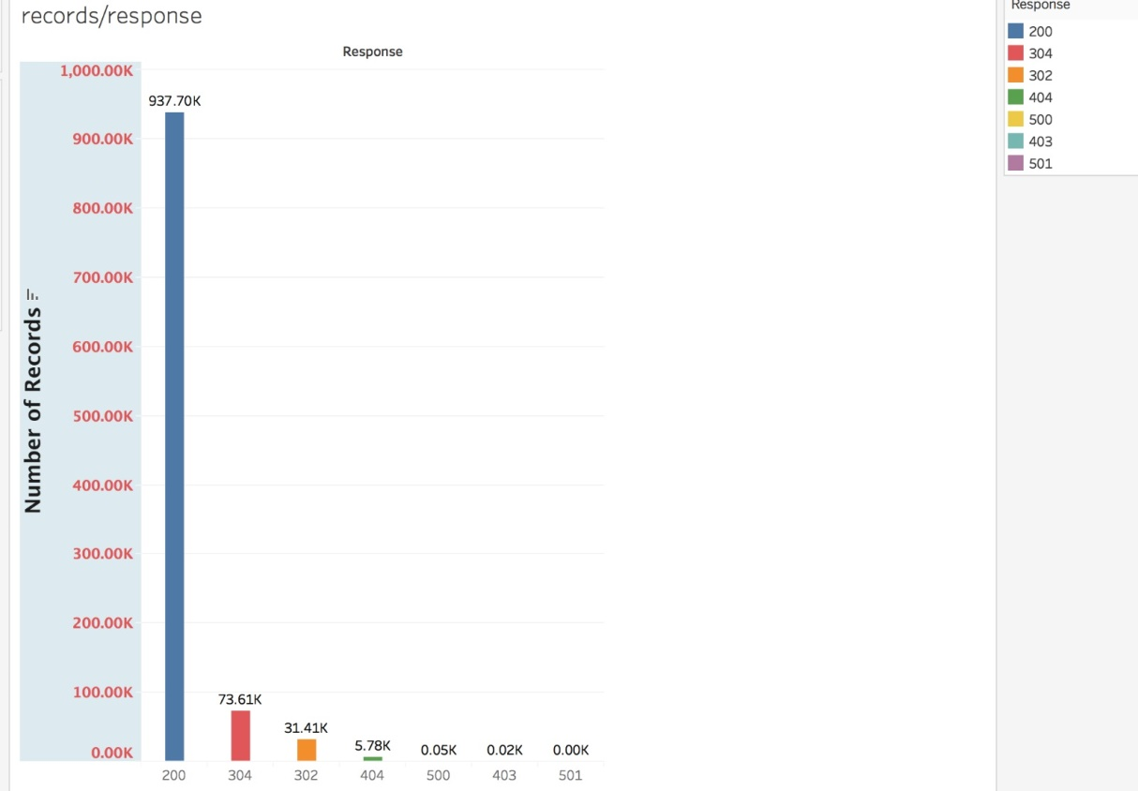
Number of Records for Each Response code

Slide 11
RECORDS/RESPONSE
ANALYSIS:As the no. of responses for given records increases,error rate increases.
There will be more no. of errors for a given record.So efficiency, and stability decreases.
PREDICTIONS:As the error rate increases ,there is a chance of instability of the system.
As the error rate increases,data rate also increases.So chance of noise and disturbances may occur

Slide 12
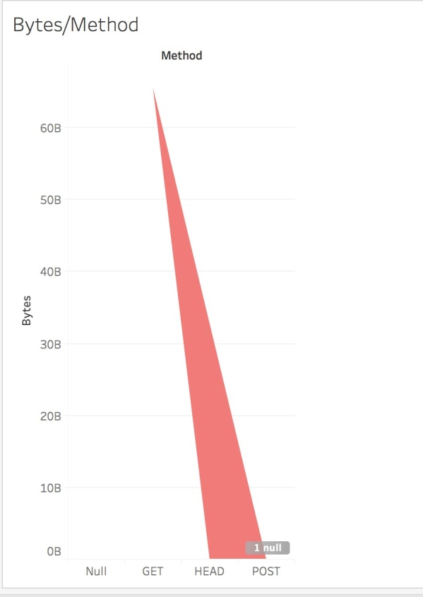
Bytes Per Method

Slide 13
METHOD/BYTES
ANALYSIS: The number of bytes for getting the data by the user are more when compared to remaining methods like post,head.
User does’t use the post method in this scenario
PREDICTIONS:As more no.of bytes are used for post method,there will be more memory used for processing the data.
Hence there will be a mpact on CPU usage time and application time.
Memory shortage and leaks leads to instability.So we need to optimize garbage collection.

